Slide 1

ICT Learning Centre @ UL - Python and ML Foundations
ML - Classification

Slide 2

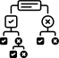
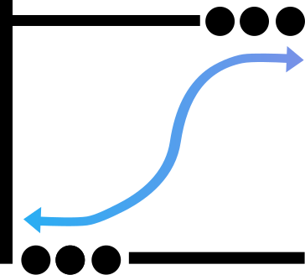

Agenda
Classification - Predict a category or label

Slide 3
Supervised Learning
Model learns from ‘known’ data (labelled)
Makes predictions on unseen data
Supervised Learning
Continuous
Categorical
Regression
Classification

Slide 4

Classification in a nutshell
Max heart rate
Age

Slide 5
Decision Trees
if ... then relationships
Root Node
Age > 55
Splitting
True
False
Decision Node
MHR < 150
MHR > 170
Leaf Node

Slide 6


Decision Trees
Highly interpretable
Root Node
Age > 53.456
Prone to overfitting
Splitting
Decision Node
Leaf Node

Slide 7
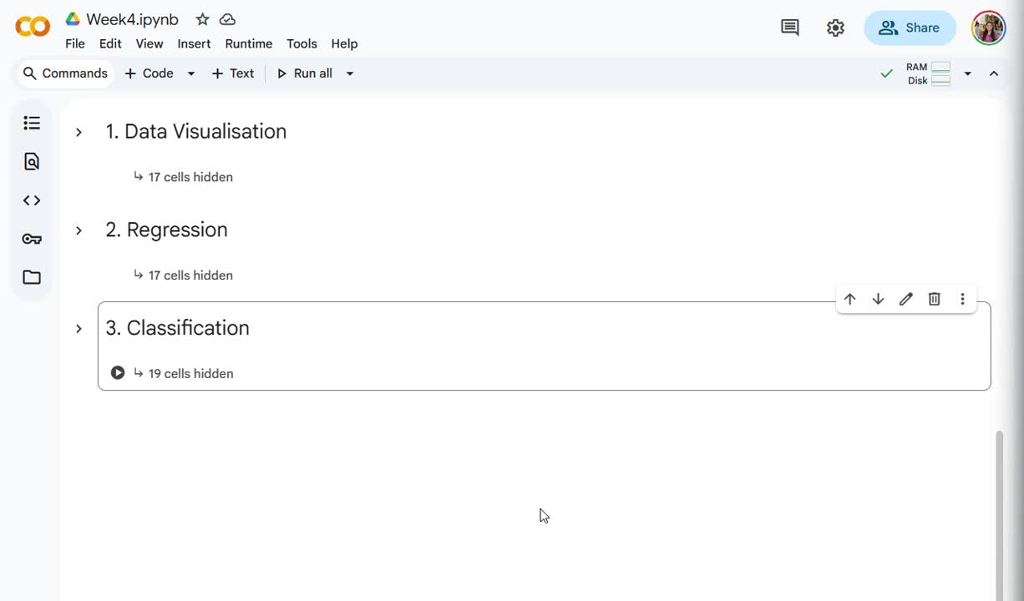

Slide 8
1 →
0 →

Slide 11
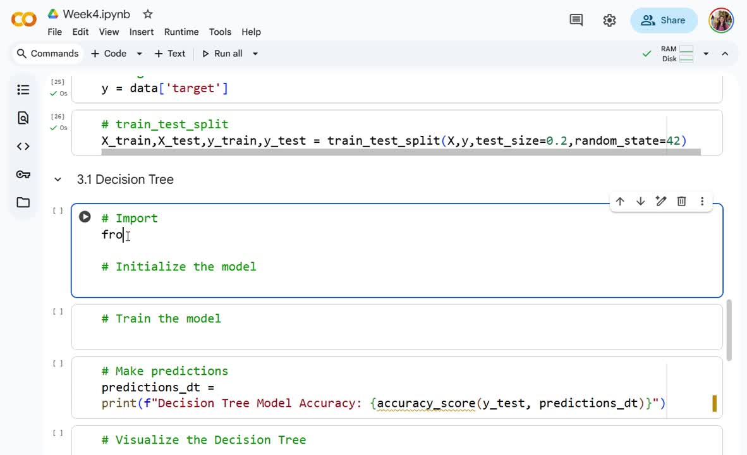

Slide 22










Logistic Regression
Logistic Regression
y
^
 |  |  | ...
Multiple input features
Classification
x

Slide 23
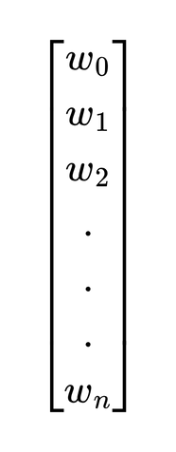
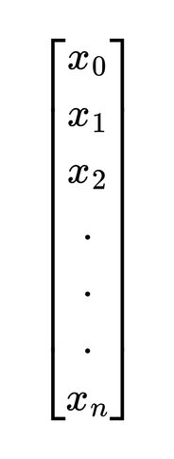

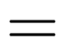


Logistic Regression

Slide 24
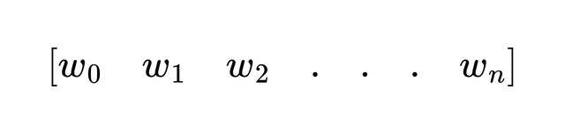
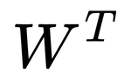

Logistic Regression

Slide 25


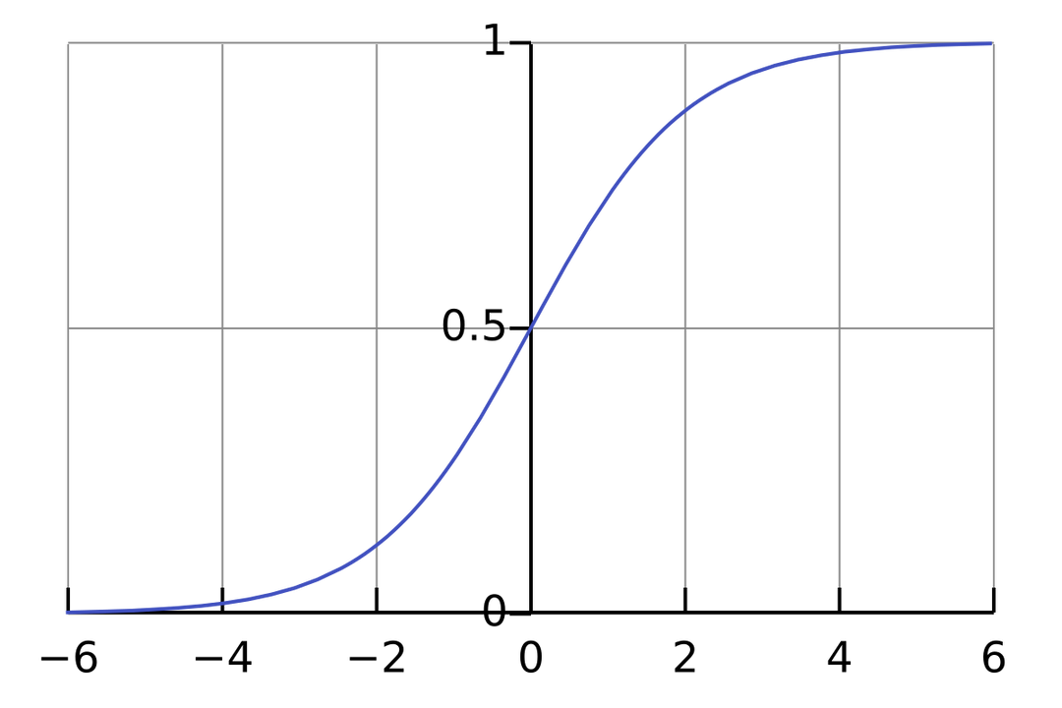
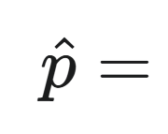

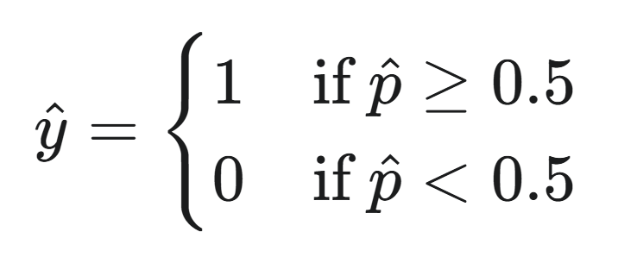

Sigmoid function
0.85

Slide 26
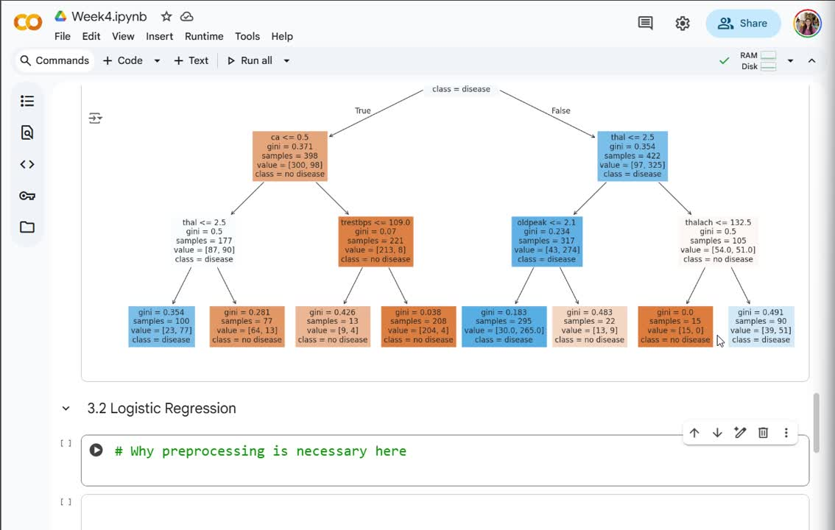

Slide 27


Slide 36
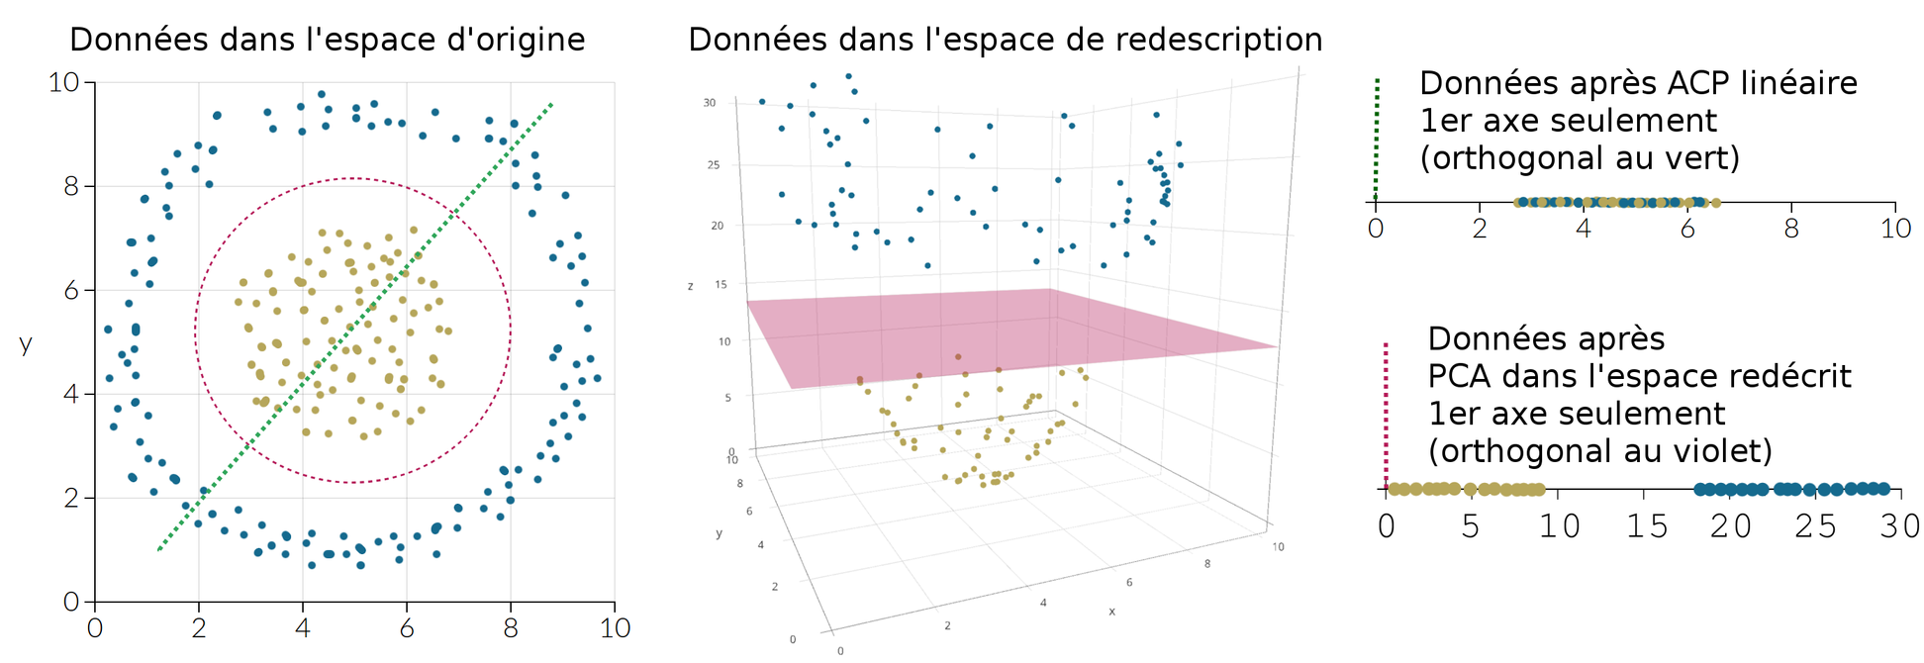

Support Vector Machines (SVMs)
Kernel trick

Slide 37
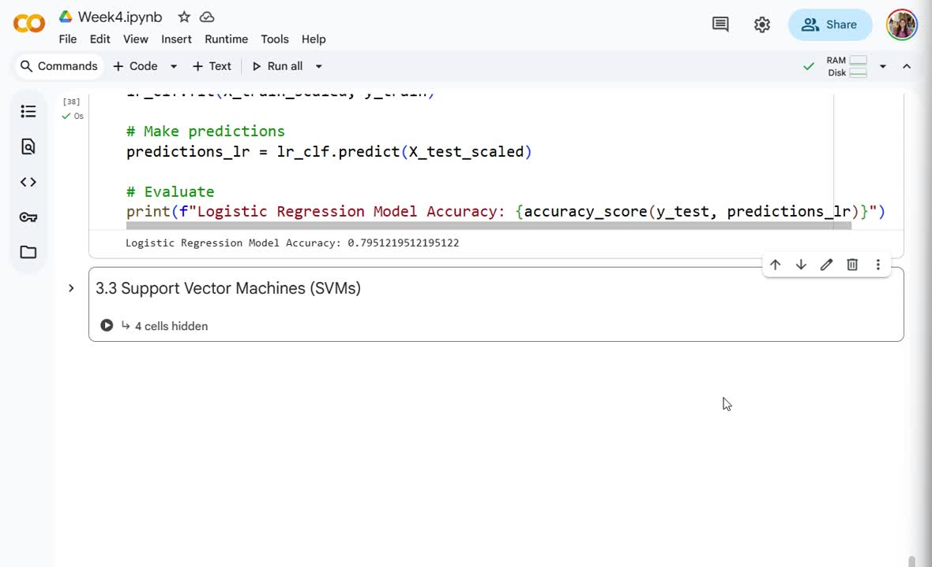

Slide 40
Recap
3 classification models
:)
Highly interpretable
Fast & simple
Uses data points closest to boundary to maximise margin of error
Prone to overfitting!!!
Uses sigmoid with threshold to classify

Slide 41

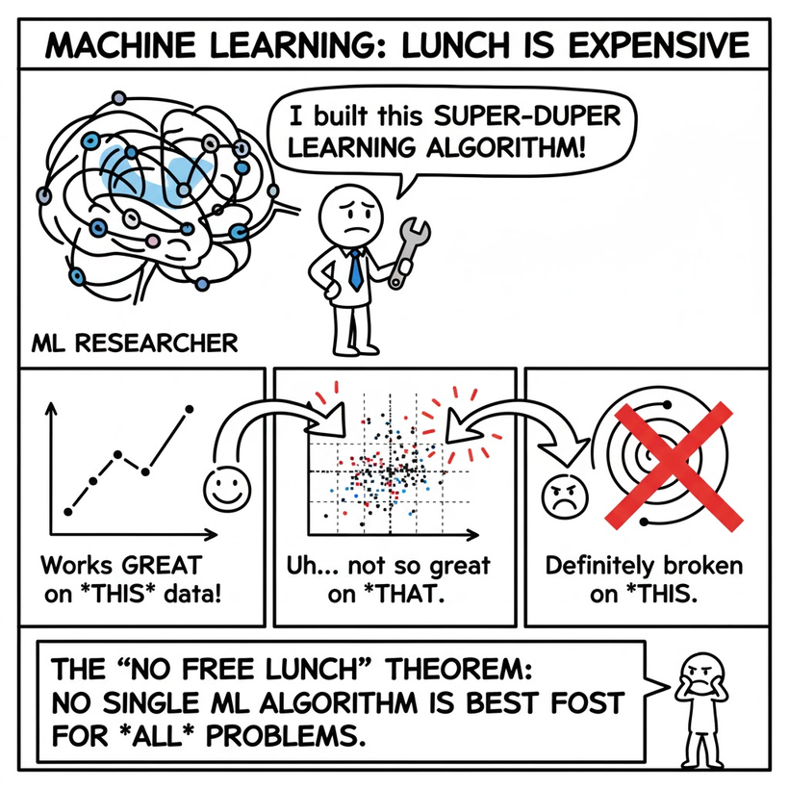

No free lunch theorem
No single best model for every problem!
There are many other classification algorithms to explore...

Slide 42

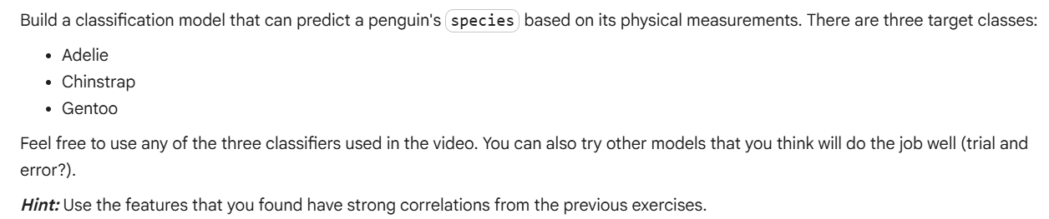
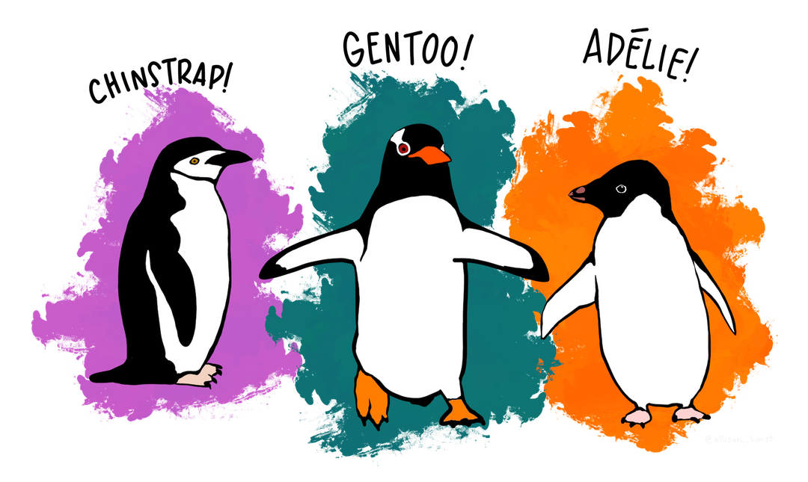
Practice Question
Artwork by @allison_horst

Slide 43

ICT Learning Centre,
CS1-046,
CSIS Building,
University of Limerick,
http://ictlc.ul.ie/contactus
Thank you

